Slide 1
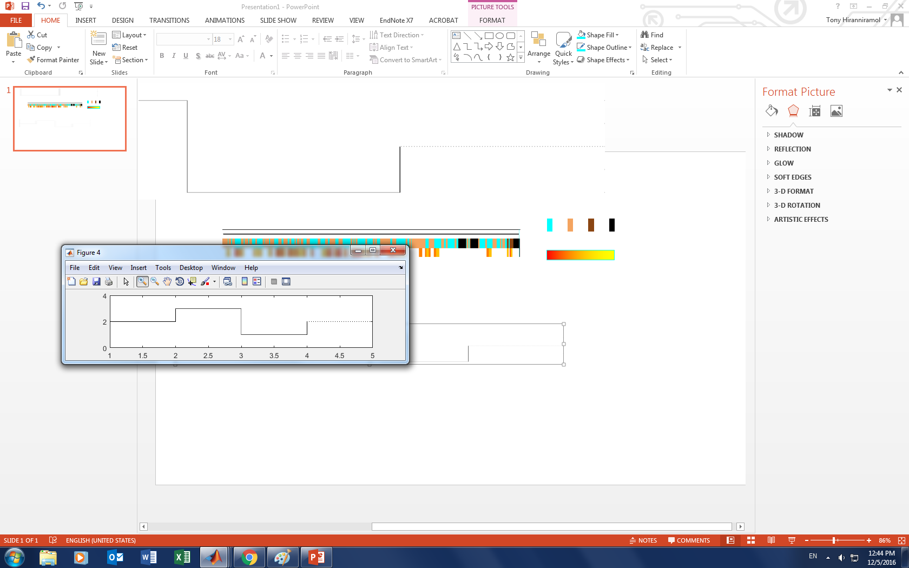
Position:
supine
LLR
RLR
prone
Sleep Quality:
restful
restless
arousal
wake
PLM:
many
few

